Slide 1
FDA304 Pitch.
Sam Cox.

Slide 2
Basic Concept.
2D Isometric Shooter.
Engine: Unity 2D.
Set in a city at night-time.
2 Weapons, melee and guns.
Timed game.
Unity 2021.3.9f1, Visual Studio Code/JetBrains Rider, C#, GIMP (GNU Image Manipulation Program), GitHub Desktop/Git, Adobe Photoshop, Adobe Fresco (iPad), Microsoft Visio (web).
Emotional responses: Intense, Excited, Thinking-ahead-of-time.

Slide 3
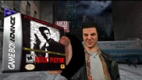
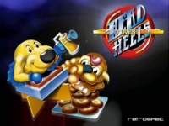
Game Inspiration.

Slide 4
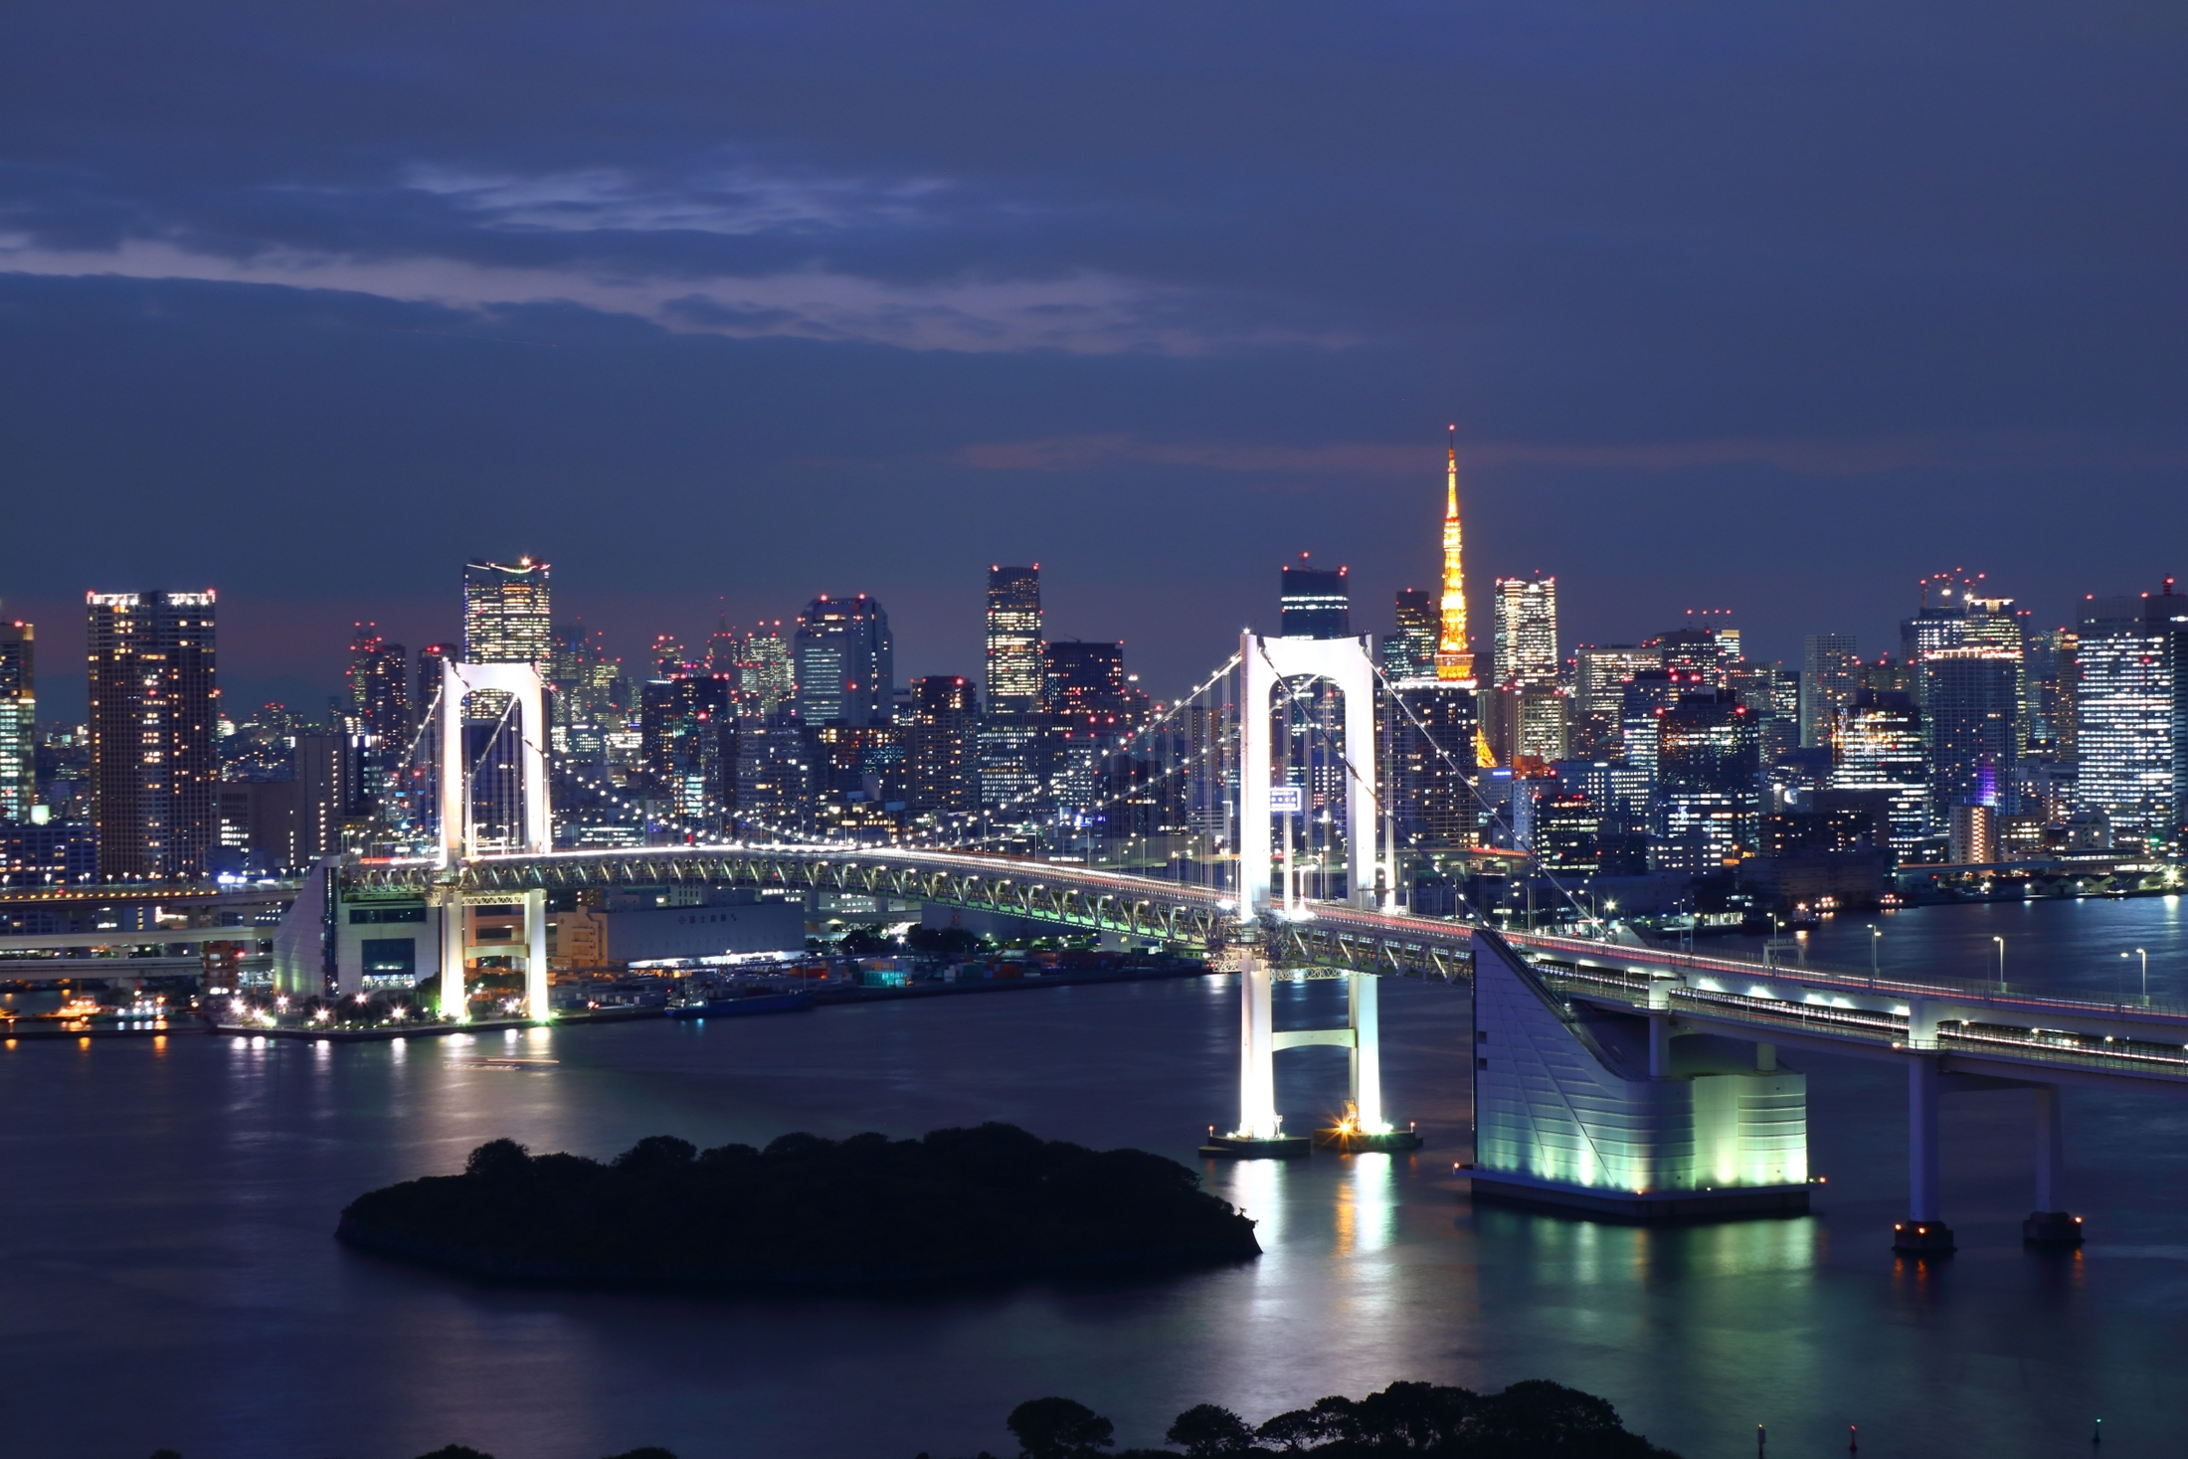
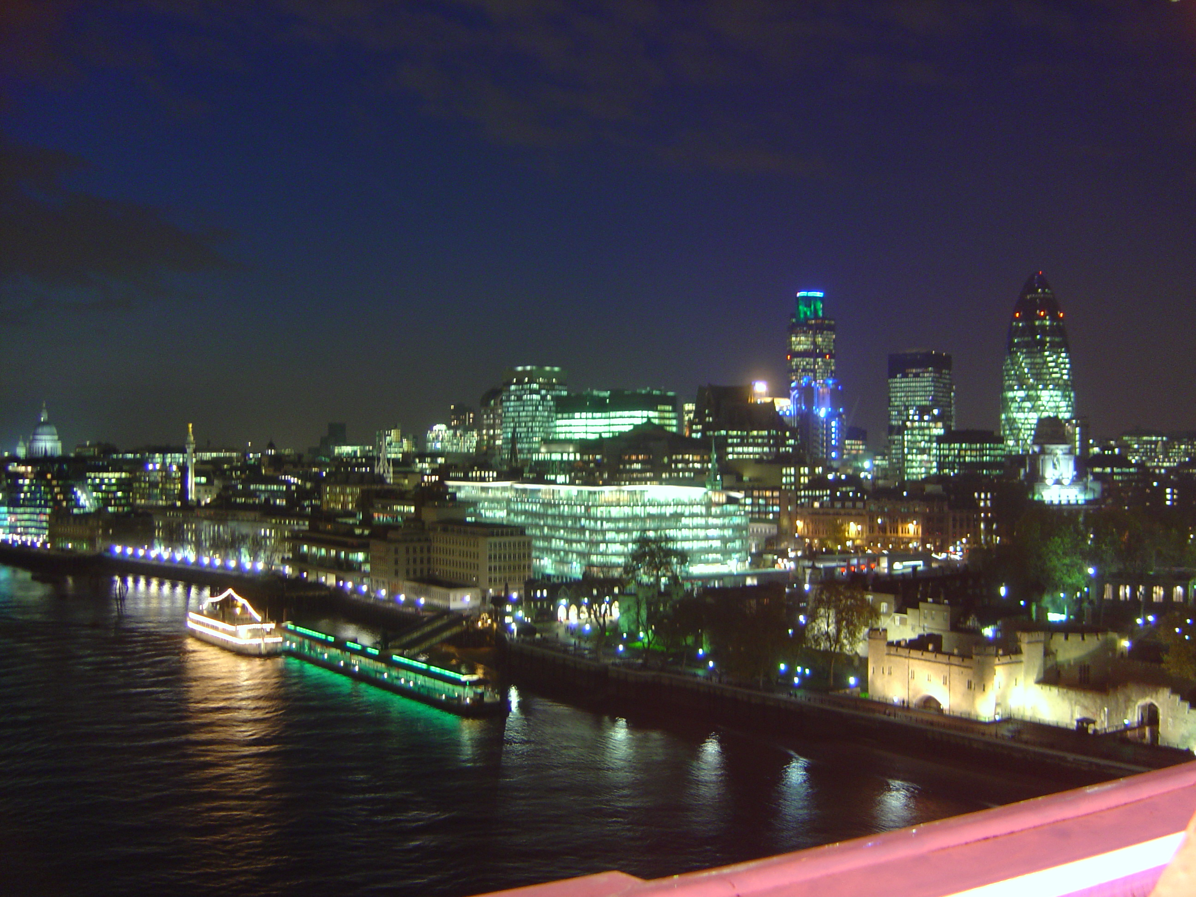
Art Inspiration.
City of London at night.jpg. (2005, December 21). Wikimedia Commons. https://commons.wikimedia.org/wiki/File:City_of_London_at_night.jpg
Rainbow Bridge (Tokyo) at night 10.jpg. (2016, November 3). Wikimedia Commons. https://commons.wikimedia.org/wiki/File:Rainbow_Bridge_%28Tokyo%29_at_night_10.jpg

Slide 5
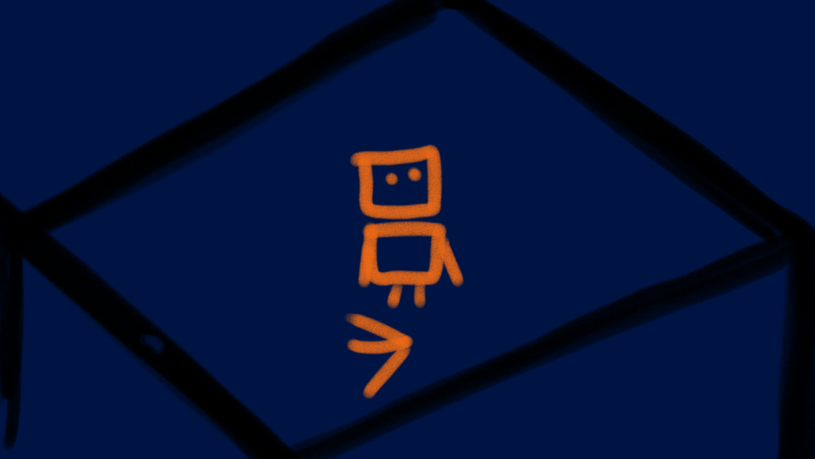
Concept Art.

Slide 6
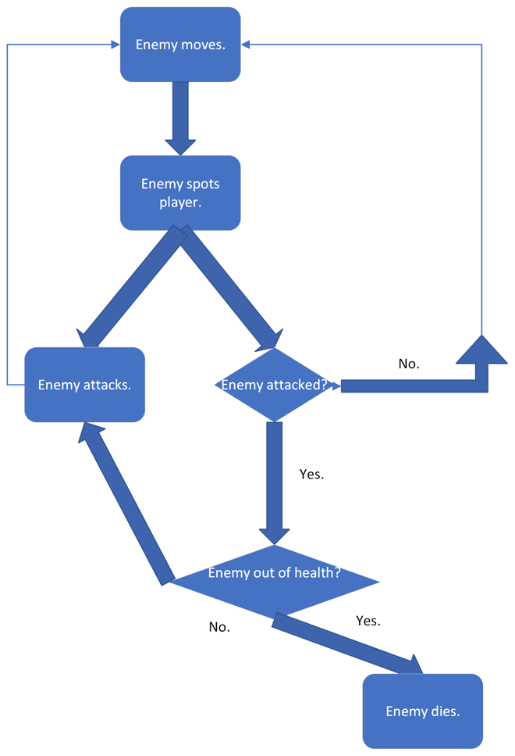

Flowcharts.

Slide 7
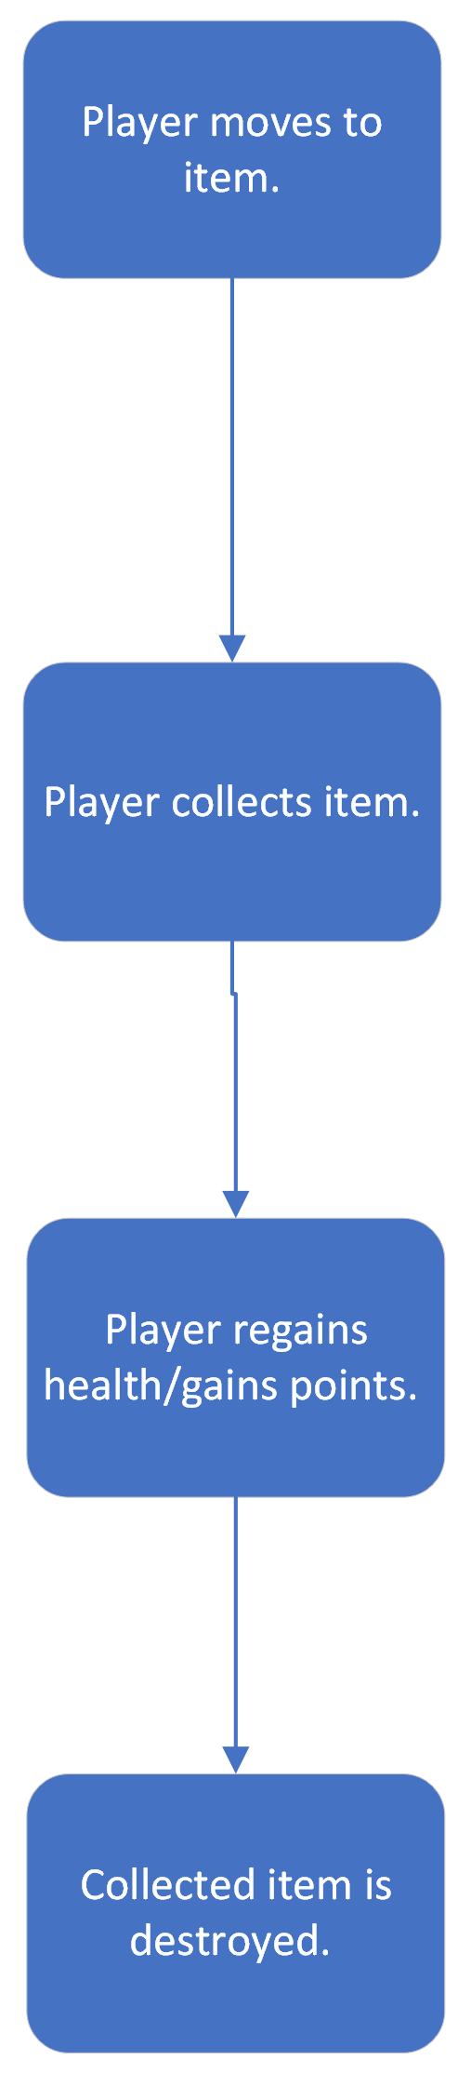
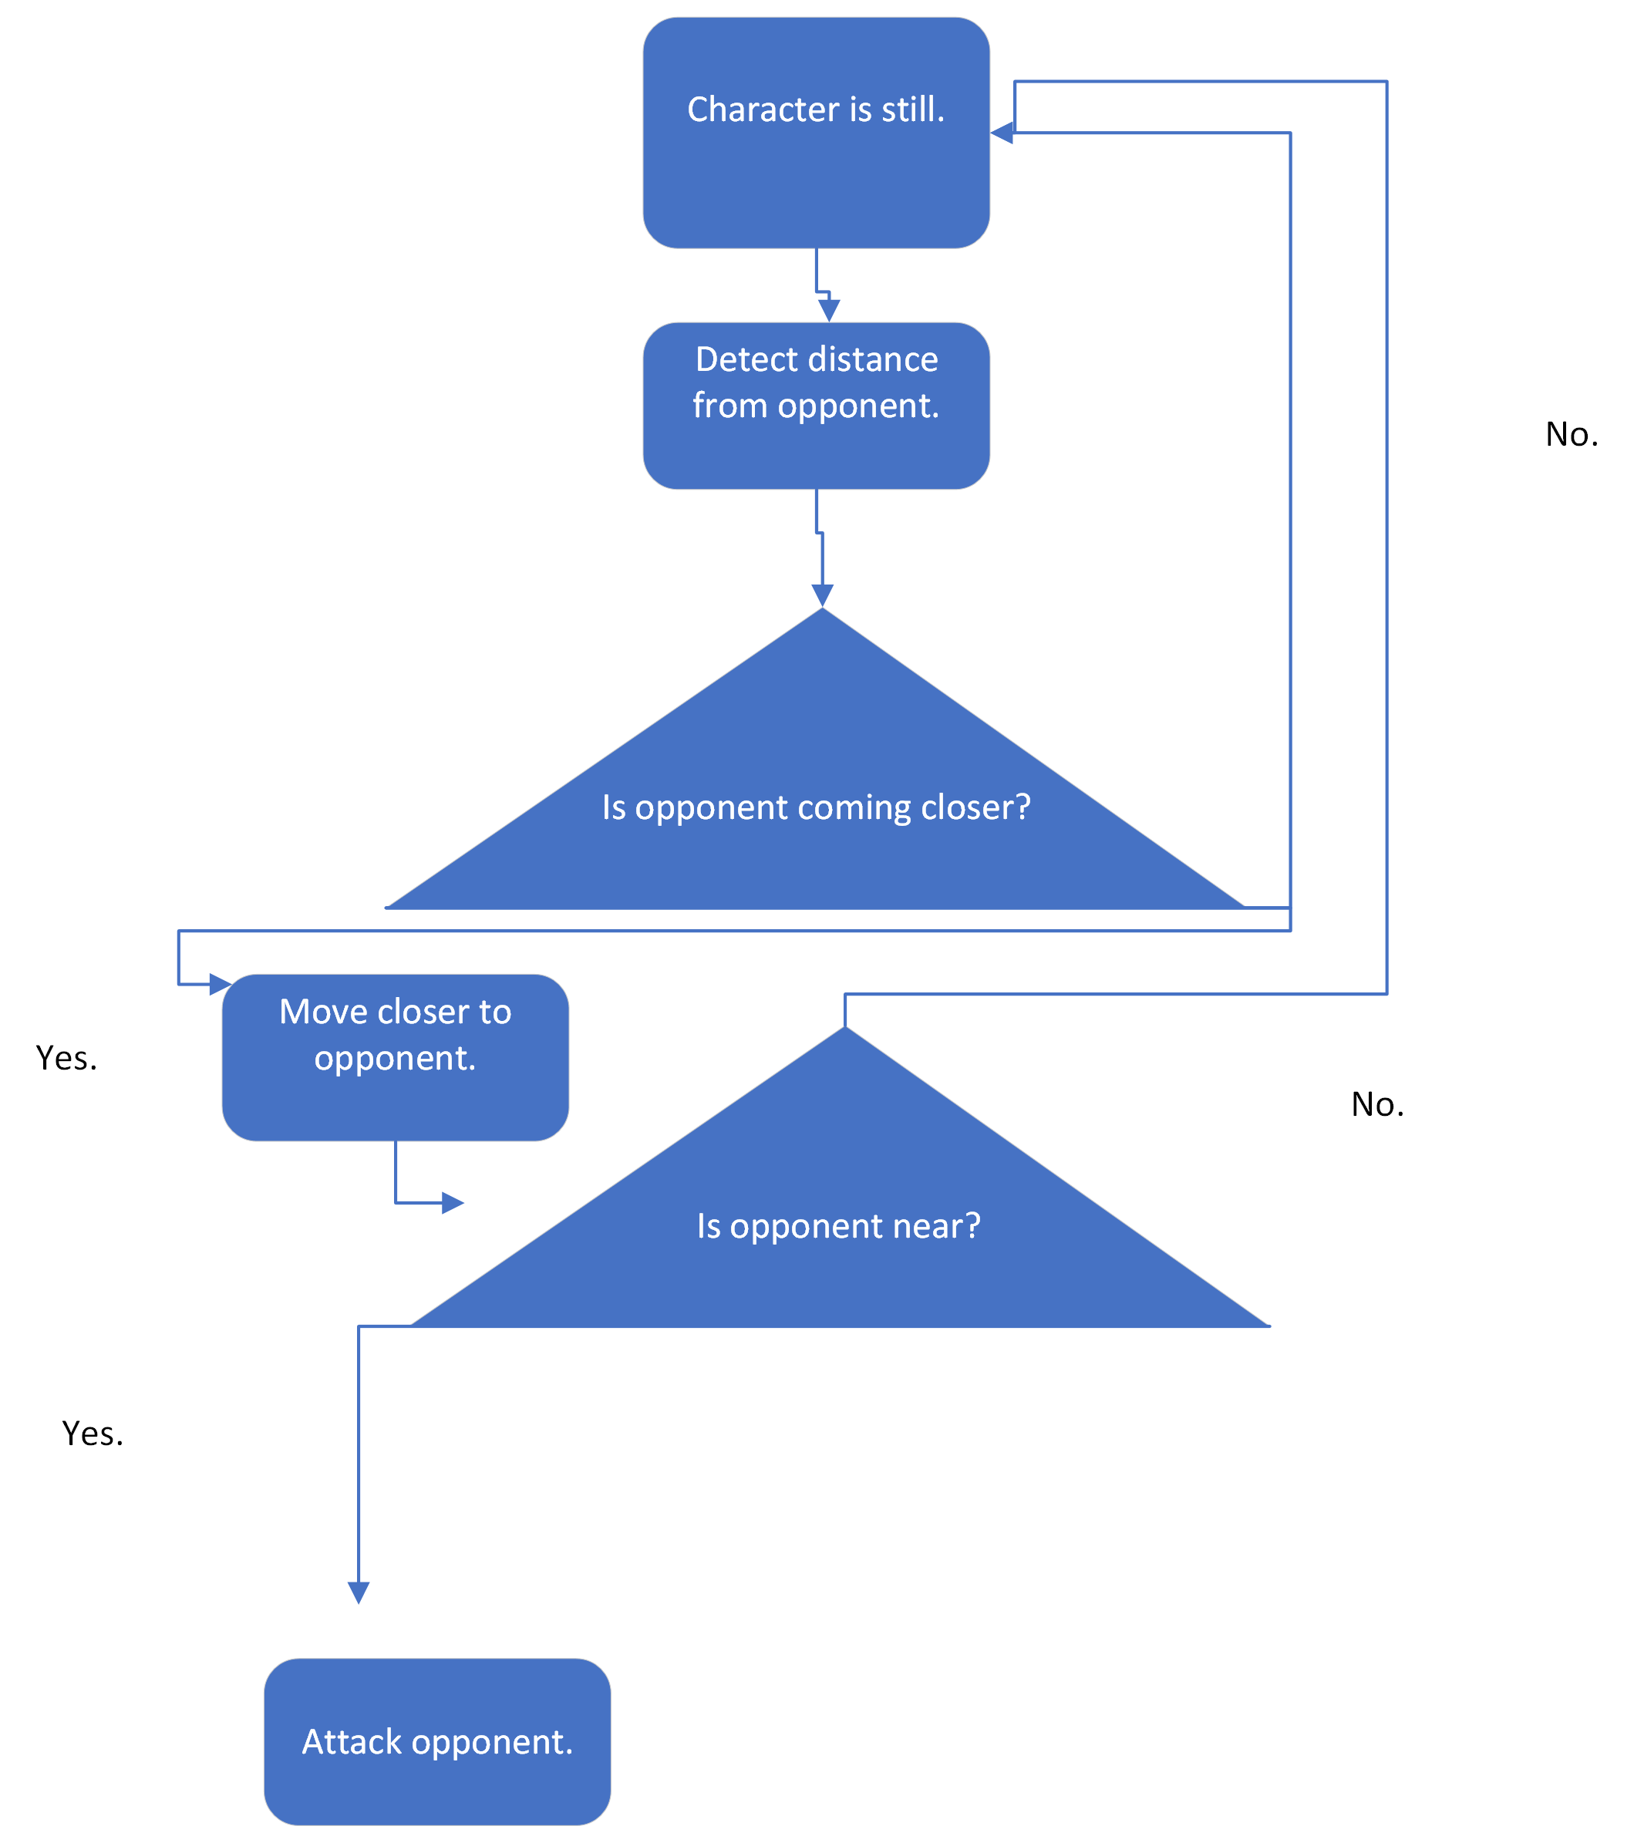
Flowcharts.

Slide 8
Key Dates.
Pre-Production complete: 07/02/23.
Milestone 2 complete: 27/03/23.
Levels complete: 27/03/23.
Polish complete: 17/04/23.
Launch: 18/04/23.

